Slide 1
PACP Implementation Guide
v1.3.0
Lisa Nelson, MS MBA
August 20, 2022

Slide 2
Ballot History and Development
2015 Began first Patient Generated Document – PACP
Large industry group, 15 different types of advance directives
2016 PACP R1 STU 1
2018 C-CDA Supplemental Templates for Advance Directives R1 STU 1
2019 PACP R1 STU 2
2021 C-CDA Supplemental Templates for Advance Directives R1 STU 2
2022 PACP R1 STU 3

Slide 3
Information Relationships: Combined View R1 STU 2
Personal
Advance Care Plan
Clinical Summary*
Care Plan
Header
Header
Header
Personal Advance Care Plan
Healthcare Agents
Health Concerns
Other Sections
1
7
Procedures
GPP Certain Conditions
Goals
4
11
2
8
Results
GPP After Death
Interventions
5
10
Plan of Treatment
GPP for Personal Care Experience
Evaluations & Outcomes
6
3
9
Advance Directives
Witness & Notary
Advance Directives
Open
Template
* Continuity of Care Document, Consultation Note, Referral Summary, Transition of Care Document
GPP = Goals, Preferences, and Priorities

Slide 4
Information Relationships: Combined View R1 STU3 (aligned with FHIR ADI)
Personal
Advance Care Plan
Clinical Summary*
Care Plan
Header
Header
Header
Administrative Information
Health Concerns
Other Sections
Healthcare Agents Appointment
1
7
Procedures
Goals
GPP for Personal Care Experience
4
11
2
8
Results
GPP Certain Conditions
Interventions
5
10
GPP After Death
Plan of Treatment
Evaluations & Outcomes
6
3
9
Additional Documentation
Advance Directives
Advance Directives
Witness & Notary
Open
Template
* Continuity of Care Document, Consultation Note, Referral Summary, Transition of Care Document
GPP = Goals, Preferences, and Priorities

Slide 5
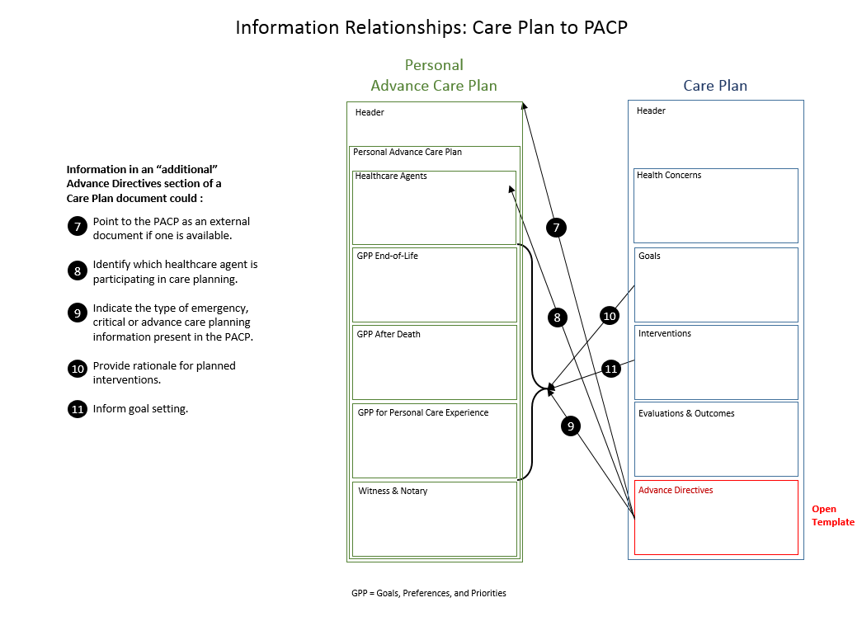
Information Relationship: Care Plan to PACP
Personal
Advance Care Plan
Care Plan
Header
Header
Administrative Information
Health Concerns
Healthcare Agents Appointment
7
Goals
GPP for Personal Care Experience
8
11
GPP Certain Conditions
Interventions
10
GPP After Death
9
Evaluations & Outcomes
Additional Documentation
Advance Directives
Witness & Notary
Open
Template
GPP = Goals, Preferences, and Priorities

Slide 6
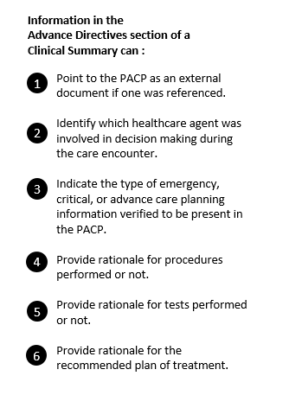
Information Relationships: Clinical Summary to PACP document
Personal
Advance Care Plan
Clinical Summary*
Header
Header
Administrative Information
Other Sections
Healthcare Agents Appointment
1
Procedures
GPP for Personal Care Experience
4
Results
2
GPP Certain Conditions
5
GPP After Death
Plan of Treatment
6
3
Additional Documentation
Advance Directives
Witness & Notary
* Continuity of Care Document, Consultation Note, Referral Summary, Transition of Care Document
GPP = Goals, Preferences, and Priorities

Slide 7
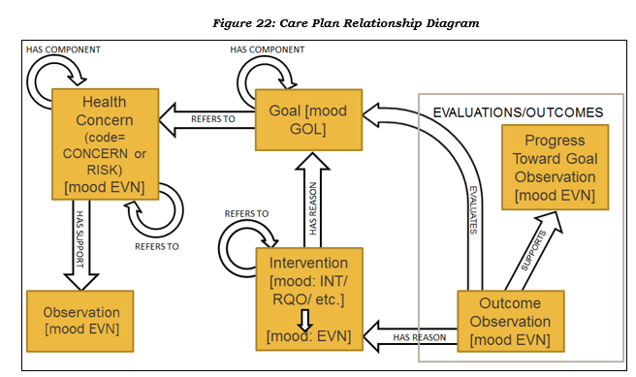
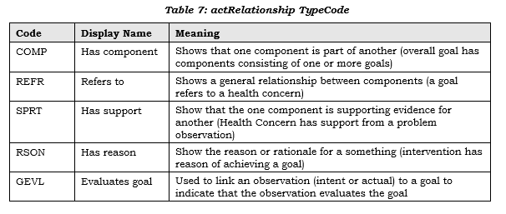
Care Plan
Header
Has component
Refers to
Health Concerns
Has support
Refers to
Has component
Goals
Has reason
Refers to
Interventions
Evaluates goal
Has support
Evaluations & Outcomes
Has reason
Advance Directives
Open
Template

